Slide 1
Image Synthesis using DCGANS
Yash Patel, Gaurav Maheshwari

Slide 2
Project Description
Generating images using the Generative Adversarial Network[1] with the training procedures and optimization techniques as described in Unsupervised representation learning with deep convolutional generative adversarial networks[2].

Slide 3
Generative models and their importance
A model P(X; 𝛳) that we can draw samples from.
Importance:
Understanding P(X) may help us understand P(Y|X).
Generating novel content.

Slide 4
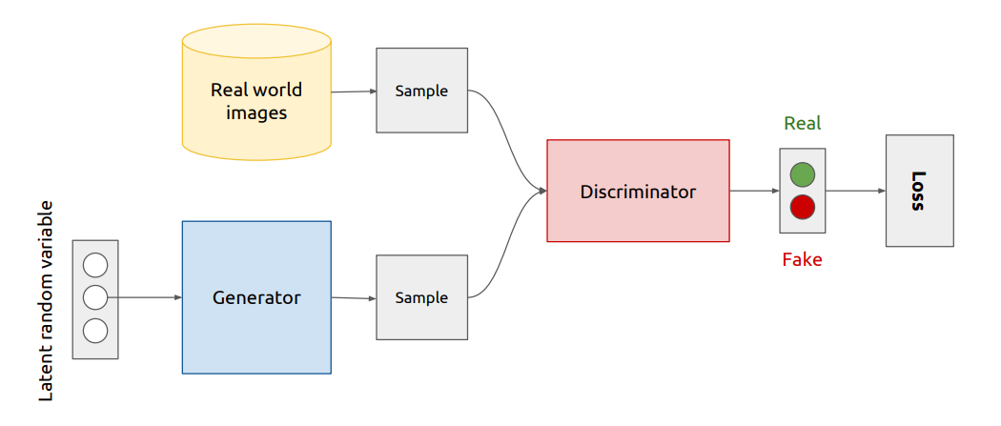
Overview: GAN architecture

Slide 5

Training GAN’s (1)
Back propagate error
to update the
discriminator weights

Slide 6
Training GAN’s (2)
Back propagate error
to update the
generator weights

Slide 7
GAN: Mathematical Notation

Slide 8
DCGANS - Guideline for Stable learning
Replace pooling layer with strided convolutions layers.
Batch normalization in all layers
Remove fully connected hidden layers for deeper architectures.
Use ReLU activation in generator for all layers except for the output, which uses Tanh.
Use LeakyReLU activation in the discriminator for all layers.

Slide 9
Task 1
Training DCGAN on Imagenet-1k
Training a linear-SVM model by extracting the features from the discriminator and test it on Food101 dataset[3].

Slide 10
Characteristics
The dataset consists of 1k classes.
Parameters
15 epochs
1024 batch size
2 x 10⁻³ learning rate
0.5 𝛽₁ for Adam optimizer and noise vector of size 100

Slide 11
Feature vectors from the Discriminator
Create feature vectors by passing all the convolution layers of discriminator through a max pooling layer to produce a 4 × 4 spatial grid. These features are then flattened and concatenated to form a 15360 dimensional vector.

Slide 13
9.6%
The accuracy was about 9.6%. We believe that the accuracy could be improved by increasing the number of epochs while training the model.

Slide 14
Task 2
Training DCGAN on LSUN Church Outdoor dataset.

Slide 15
Characteristics
The dataset consists of 126227 images of church outdoor.
Parameters
25 epochs
64 batch size
2 x 10⁻³ learning rate
0.5 𝛽₁ for Adam optimizer and noise vector of size 100

Slide 16
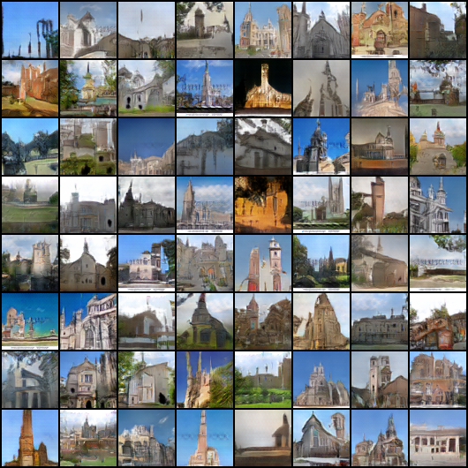
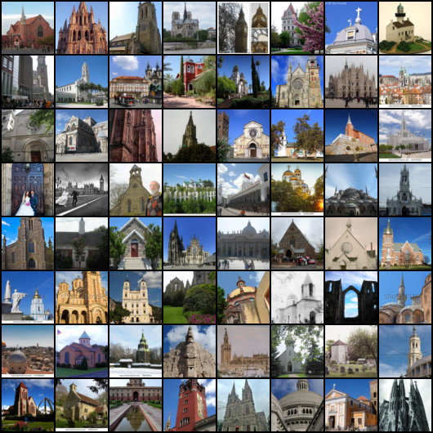

Slide 17
Task 3
Training DCGAN on Caltech-UCSD Birds-200-2011 dataset[4].
Perform vector arithmetic operations over the generated images.

Slide 18
Characteristics
The dataset consists of 11778 images of Church outdoors.
Parameters
100 epochs
64 batch size
2 x 10⁻³ learning rate
0.5 𝛽₁ for Adam optimizer and noise vector of size 100

Slide 19
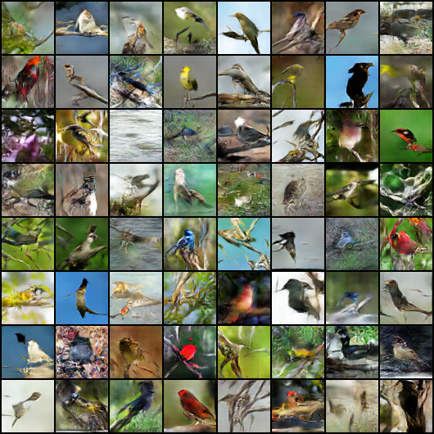
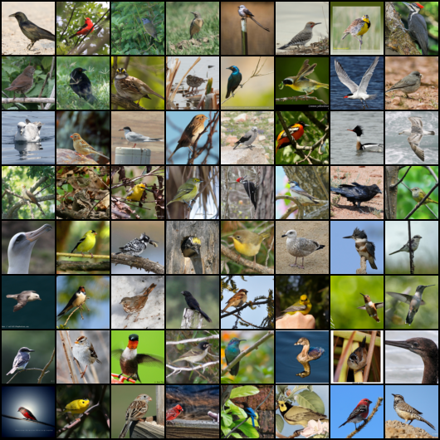

Slide 20
Vector arithmetic operations
Arithmetic operations on word embeddings reveal interesting structure in representation space.
Similar structure is revealed in the Z (noise vectors) representation of the generators.

Slide 21
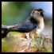
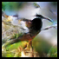
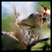
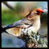
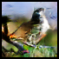
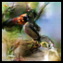
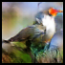
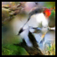
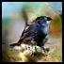
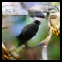
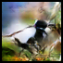
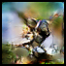
-
+
=
=
-
+
-
+
=
Using Single Images

Slide 22
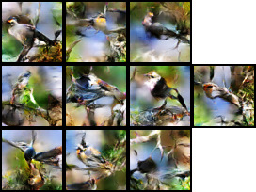
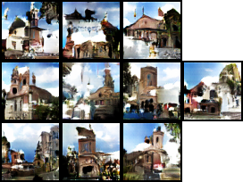
-
-
=
=
+
+

Slide 23
A simple alternative training procedure
Update the weights of discriminator on every second batch and generator on each batch.

Slide 24
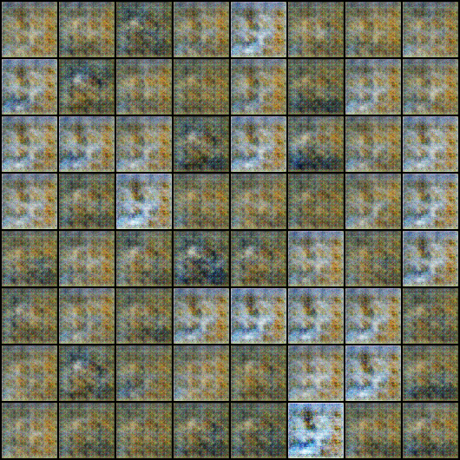

Slide 25
Modelling power of Discriminator needs to be more than that of the generator.
Models were very sensitive to hyper-parameters.

Slide 26
Citations
[1] - Goodfellow, Ian, et al. "Generative adversarial nets." Advances in neural information processing systems. 2014.
[2] - Radford, Alec, Luke Metz, and Soumith Chintala. "Unsupervised representation learning with deep convolutional generative adversarial networks." arXiv preprint arXiv:1511.06434 (2015).
[3]- Bossard, Lukas, Matthieu Guillaumin, and Luc Van Gool. "Food-101–mining discriminative components with random forests." European Conference on Computer Vision. Springer, Cham, 2014.
[4] - Wah, Catherine, et al. "The caltech-ucsd birds-200-2011 dataset." (2011).

Slide 27
Note
We collaborated with another group on task 1, and shared the trained Imagenet-1k model.

Slide 28
Thank you

